Slide 1
COLOR DETECTION USING OPENCV
Submitted by: KHUSHI SRIVASTAVA
CSE 4th year

Slide 2
OUTLINES:
What is color Detection
What is open CV
Required Libraries and dataset
Steps for building a color detection
Output
Future scope and Conclusion

Slide 3
What is color Detection
Colour Detection is the process of the detecting the name of any colour.
Colour detection is necessary to recognize objects, it is also used as a tool in various image editing and drawing apps.
Here we take a coloured image of 3channel (RED,GREEN,BLUE). So each pixel has a RED value ,GREEN and BLUE value .
Our aim is to retrieve these values from an image to determine the color of the pixel.

Slide 4
What is Open CV
Open CV is a Computer Vision library developed by Intel.
This library is highly used for image processing and computer vision task.
It includes filtering, edge detection, corner detection and color detection.

Slide 5
Required Library and Dataset
CV2 and panda are the required libarary.
Dataset:
Colours are made up of 3 primary colors; red, green, and blue. In computers, we define each colour value within a range of 0 to 255. In our dataset, we need to map each color’s values with their corresponding names. We will be using a dataset that contains RGB values with their corresponding names. csv file includes 865 color names along with their RGB and hex values.

Slide 6
Steps for building a color detection
1. importing required package and load the image
import cv2 import numpy as np import pandas as pd
img_path = “D://OpenCV//shape-detection//New folder//color palette.jpg” img = cv2.imread(img_path)
2. Next, we read the CSV file with pandas
The pandas library is very useful when we need to perform various operations on data files like CSV. pd.read_csv() reads the CSV file and loads it into the pandas DataFrame. We have assigned each column with a name for easy accessing.
index=[“color”,”color_name”,”hex”,”R”,”G”,”B”] csv = pd.read_csv(‘colors.csv’, names=index, header=None)

Slide 7
Continue…….
3. Next, we read the CSV file with pandas
The pandas library is very useful when we need to perform various operations on data files like CSV. pd.read_csv() reads the CSV file and loads it into the pandas We have assigned each column with a name for easy accessing.
index=[“color”,”color_name”,”hex”,”R”,”G”,”B”] csv = pd.read_csv(‘colors.csv’, names=index, header=None)
4. Set a mouse callback event on a window
First, we created a window in which the input image will display. Then, we set a callback function which will be called when a mouse event happens.
cv2.namedWindow(‘color detection’) cv2.setMouseCallback(‘color detection’,draw_function)
5. Create the draw_function
It will calculate the rgb values of the pixel which we double click. The function parameters have the event name, (x,y) coordinates of the mouse position, etc. In the function, we check if the event is double-clicked then we calculate and set the r,g,b values along with x,y positions of the mouse.

Slide 8
Continue…
6. Calculate distance to get color name
d = abs(Red — ithRedColor) + (Green — ithGreenColor) + (Blue — ithBlueColor)
7. Display image on the window
Whenever a double click event occurs, it will update the color name and RGB values on the window.

Slide 9
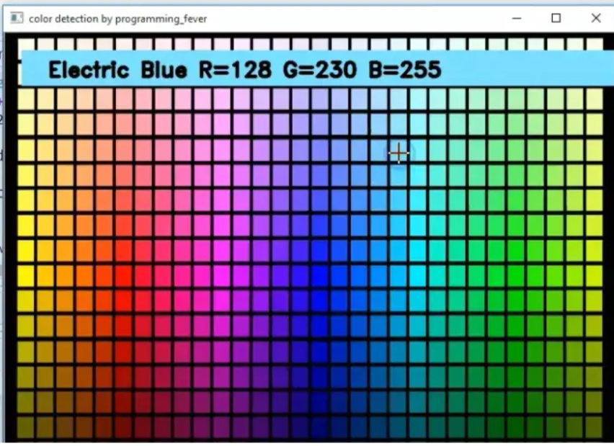
Output

Slide 10
Future scope and conclusion
Computer vision - Color detection is basic and important step for proceeding in computer vision.
Object Segregation -An object can be segregated on the basis of its color.
Object Tracking -A moving object can be tracked on the basis of its color.

Slide 11
Thank you
Notes:
Thank you

